Slide 1
Lab 1. Functions

Slide 2
Note
Before doing this lab, I assume that you have already finished homework tasks appended after lecture 0 slides
If so, proceed to the following slide.

Slide 3
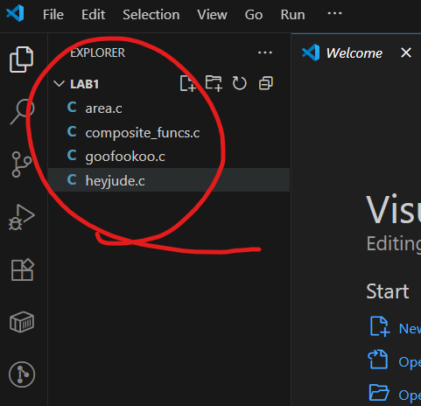
Homework 1.1
Download the lab file from the course github.
Unzip the file to a folder of your choice.
Open Visual Studio Code, and open that folder.
Your VSCode should look like the left.

Slide 4
Homework 1.1
Open heyjude.c
Trace the execution of the file, step by step, using the debugger.

Slide 5
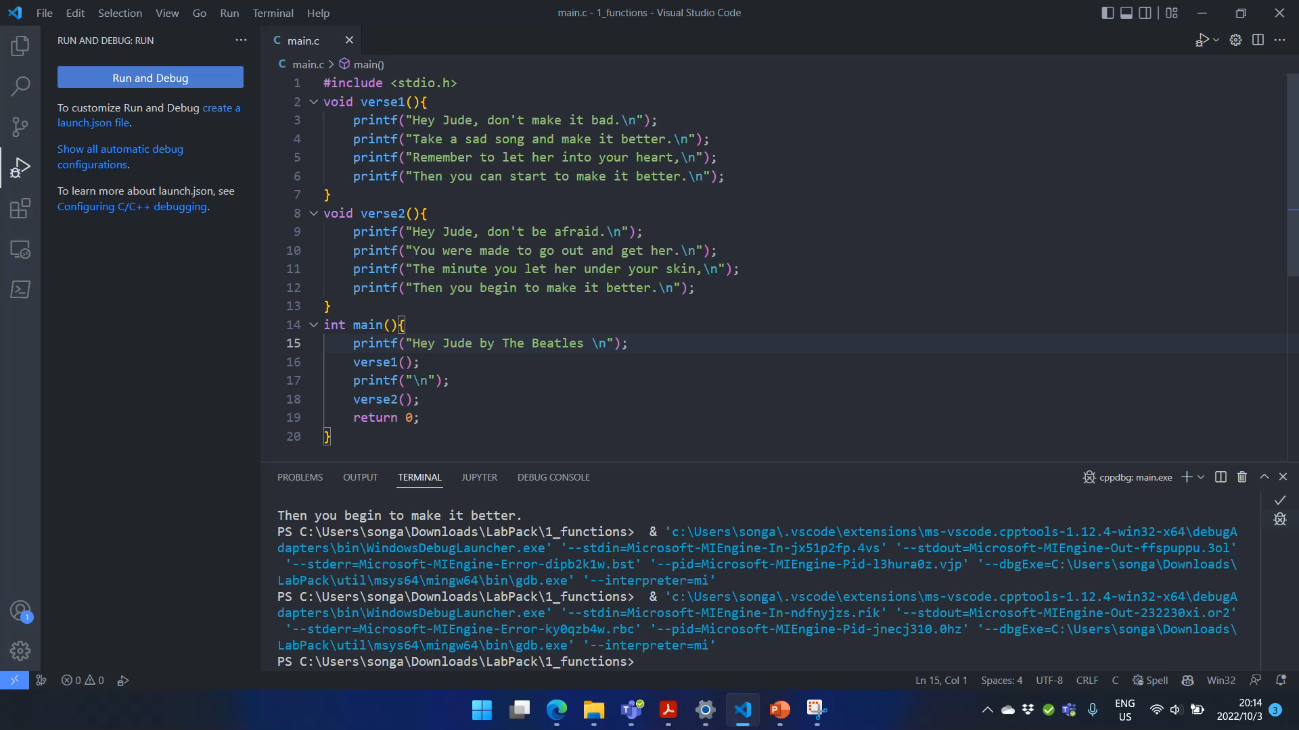
To enter a function, you need to click “Step Into” (F11), rather than click “Step Over” (F10).
If you “step over” a function, the debugger will not enter the function while it is being executed.

Slide 6
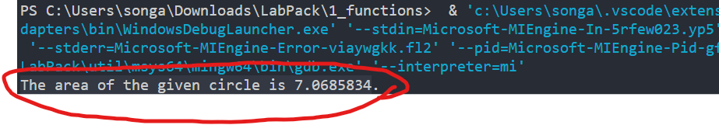
Homework 1.2
Study the “calculate_circumference” example in the lecture slides. Open file “area.c”.
Write a function named “calculate_area” which returns the area of a circle given a radius.
Your function should have 1 input and 1 output.
Write a “main” function that calls “calculate_area” and print out the returned area.
The printout should read:
“The area of the give circle is X.XXXXXXX.”

Slide 7
Homework 1.3
Open file: “goofookoo.c”
Do NOT run the code for now.
Read the code and write down the output of this program on a paper.
Now, run the code, and check your answer. Did you get it right? Use the debugger to trace the execution.
This was a last year’s written exam question.

Slide 8
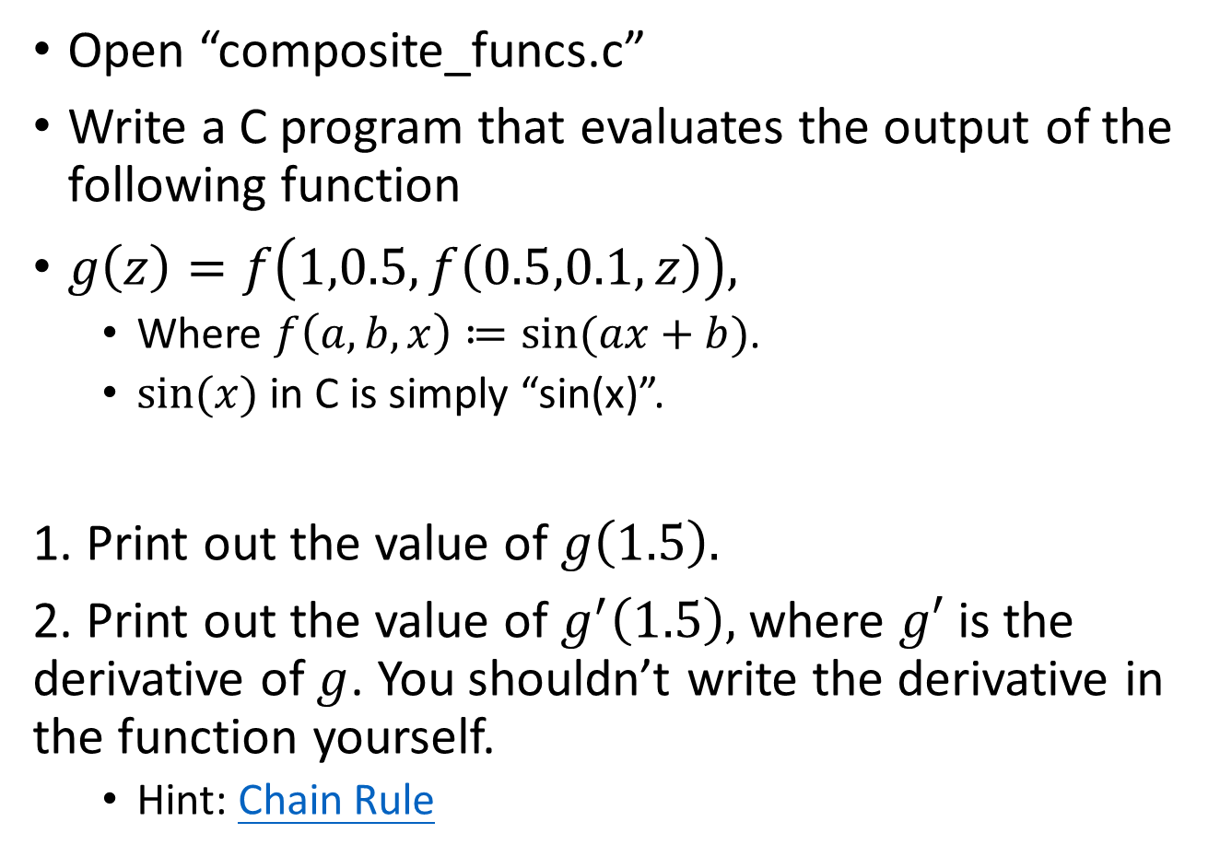
Homework 1.4 (submit this)
Open “composite_funcs.c”
Write a C program that evaluates the output of the following function
$g\left(z\right)=f\left(1,0.5,f\left(0.5,0.1,z\right)\right),$
Where $f\left(a,b,x\right)≔sin⁡(ax+b)$.
$sin⁡(x)$ in C is simply “sin(x)”.
1. Print out the value of $g\left(1.5\right).$
2. Print out the value of$g^{′}\left(1.5\right),$ where $g′$ is the derivative of $g$. You shouldn’t write the derivative in the function yourself.
Hint: Chain Rule

